Slide 1
Welcome to Android application for Student management.

Slide 2
Presented by- A.M Mahmudul Alam ID : CE18058 Name: Tushar Miah ID : CE18054 Supervised by- Md.Mezbahul Islam Assistant Professor Department Of CSE,MBSTU

Slide 3
Outline
Description
Outcomes
Functions
Operations
Welcome Screen
Input
Executed Program
Output
Shortcoming
Future Work
Reference
Conclusion

Slide 4
Description
Student Management System which allows the store and find student related activities.
It helps to display the student information easily.
This entire project built on Java language.

Slide 5
Outcomes
User can add,edit,view & delete the information .
It will Save their time and efforts.
It will more convenient to store.
It will user friendly to operate.
Smooth Interface.

Slide 6
Functions
Add Student Information: When adding a new roll number, student name, and marks, all three records will store & display a successful popup.
Delete Record: Here user can delete a record that is no more. Users can easily search them by their roll number and delete them.
Modify Record: Here user can modify a record if some changes needed
View Marks: Here user can show the specific student marks and details.
View All Student Records: Here all the information of students will record who enrolled in this educational institution. Users can search for them by their Roll number.

Slide 7
Operations
Input
Output

Slide 8
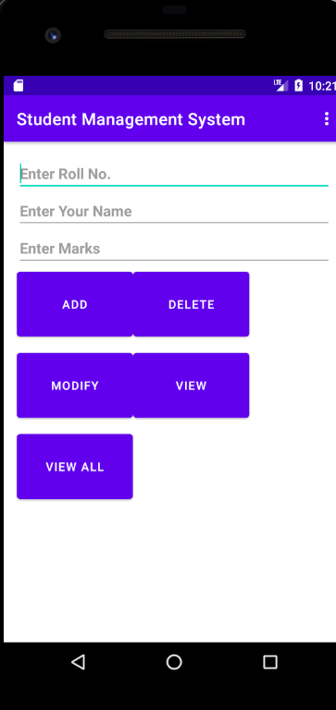
Welcome Screen

Slide 9
Input
User will take the input from keyboard which Student Roll user want to add.
After choosing Roll user need to write student name .
Than user need to input the marks which is integer type.
Than need to give input of user all necessary information

Slide 10
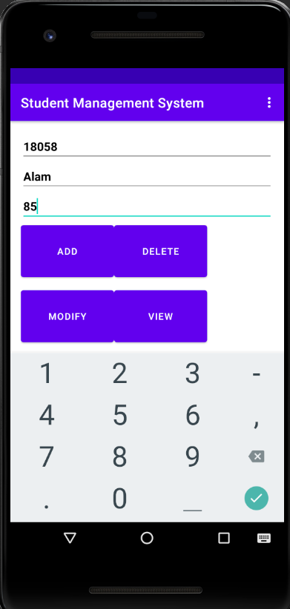
Input

Slide 11
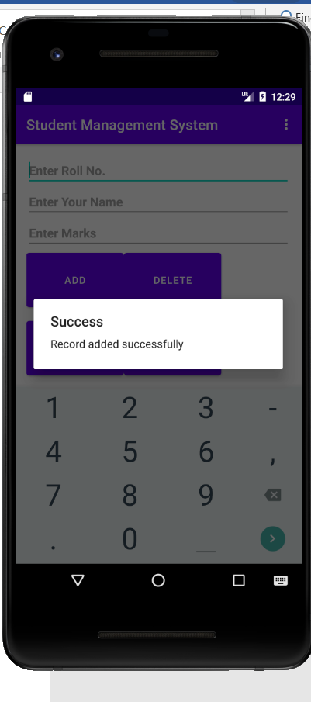
Input(continue)

Slide 12
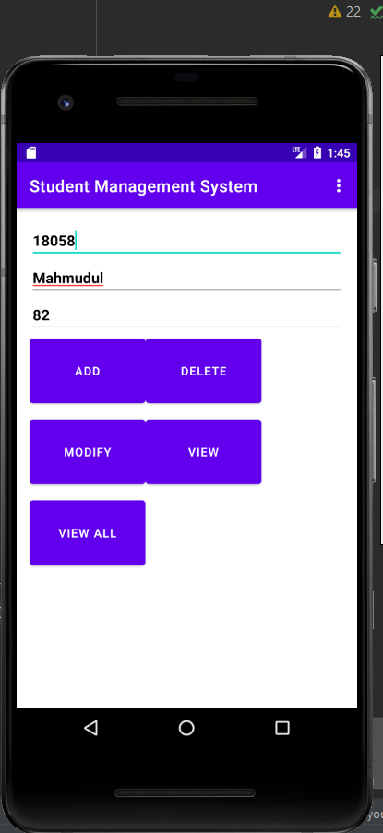
Input(continue)

Slide 13
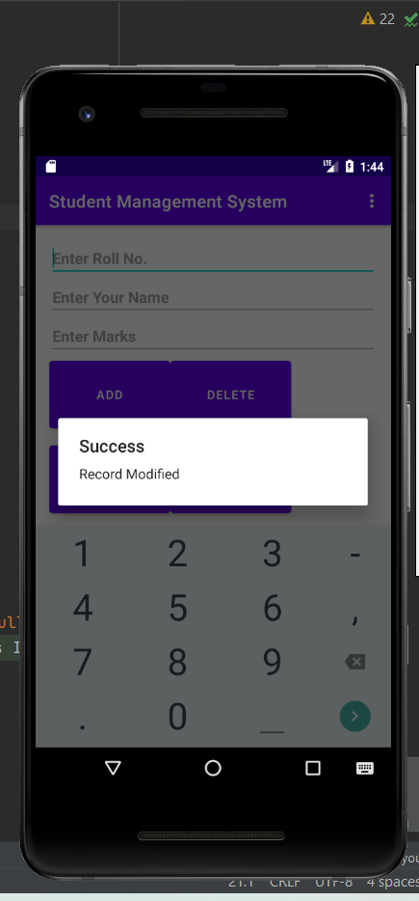
Input(continue)

Slide 14
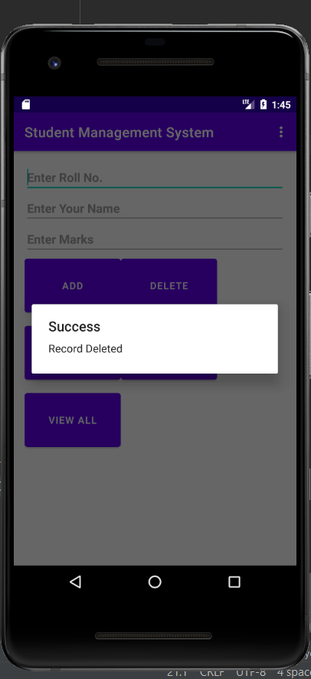
Input

Slide 15
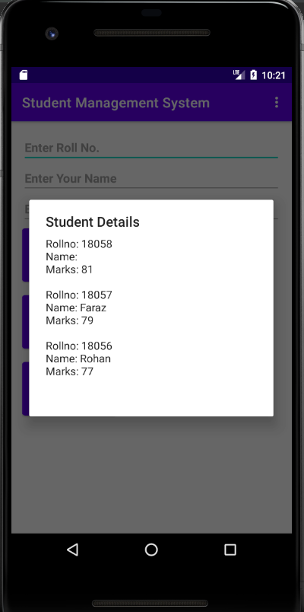
Output

Slide 16
Shortcomings:
Due to the limitation of PC, it has to make desktop base app instead of making android base app.

Slide 17
Future work:
In order to facilitate the user’s use,more information will be added
Will make it more smooth
To make the representation Of Student details more attractive, we should use several types of graphical functions.
We have to be more careful about handling the timing of the assigned task

Slide 18
Reference
https://www.tutorialspoint.com/java/java_environment_setup.htm
https://qualitestgroup.com/insights/technical-hub/how-to-add-java-to-your-system-path/
https://www.infoworld.com/article/3388036/what-is-jdbc-introduction-to-java-database-connectivity.html
(1576) JAVA - How To Design Login And Register Form In Java Netbeans - YouTube
Red CMYK color code | flatuicolorpicker : Best Flat Colors UI Design
(1576) how to auto increment varchar in sql server - YouTube
http://netbeans.apache.org/kb/docs/ide/mysql.htm
(1576) How to Connect to Microsoft SQL Server in NetBeans IDE | Java Connect to SQL Server | JDBC in Java - YouTube

Slide 19
Conclusion
This project make student management system very easy.

Slide 20
Thank You

